Slide 1


Introduction to Android Automotive OS (AAOS)
GROUP - 5
Welcome to this deep dive into Android Automotive OS (AAOS), the next-generation platform revolutionizing in-car experiences. We'll explore its unique architecture, key features, and the profound benefits it brings to both drivers and vehicle manufacturers.
NAMES | SLIDES
PRINCE | 1-5
USHA | 6-7
SUMA | 8-9
DEEPAK | 10-12
JYOTISMAN | 13

Slide 2



What is Android Automotive OS?
Full-Stack Integration
In-Car Design
Smart Driving
AAOS is a comprehensive, open-source operating system built directly into the vehicle's hardware, providing a seamless, integrated experience.
It's engineered specifically for automotive environments, focusing on infotainment, navigation, and critical vehicle control functions, unlike a smartphone projection.
AAOS powers intelligent, connected, and safe driving experiences, making vehicles smarter and more intuitive for users worldwide.

Slide 3
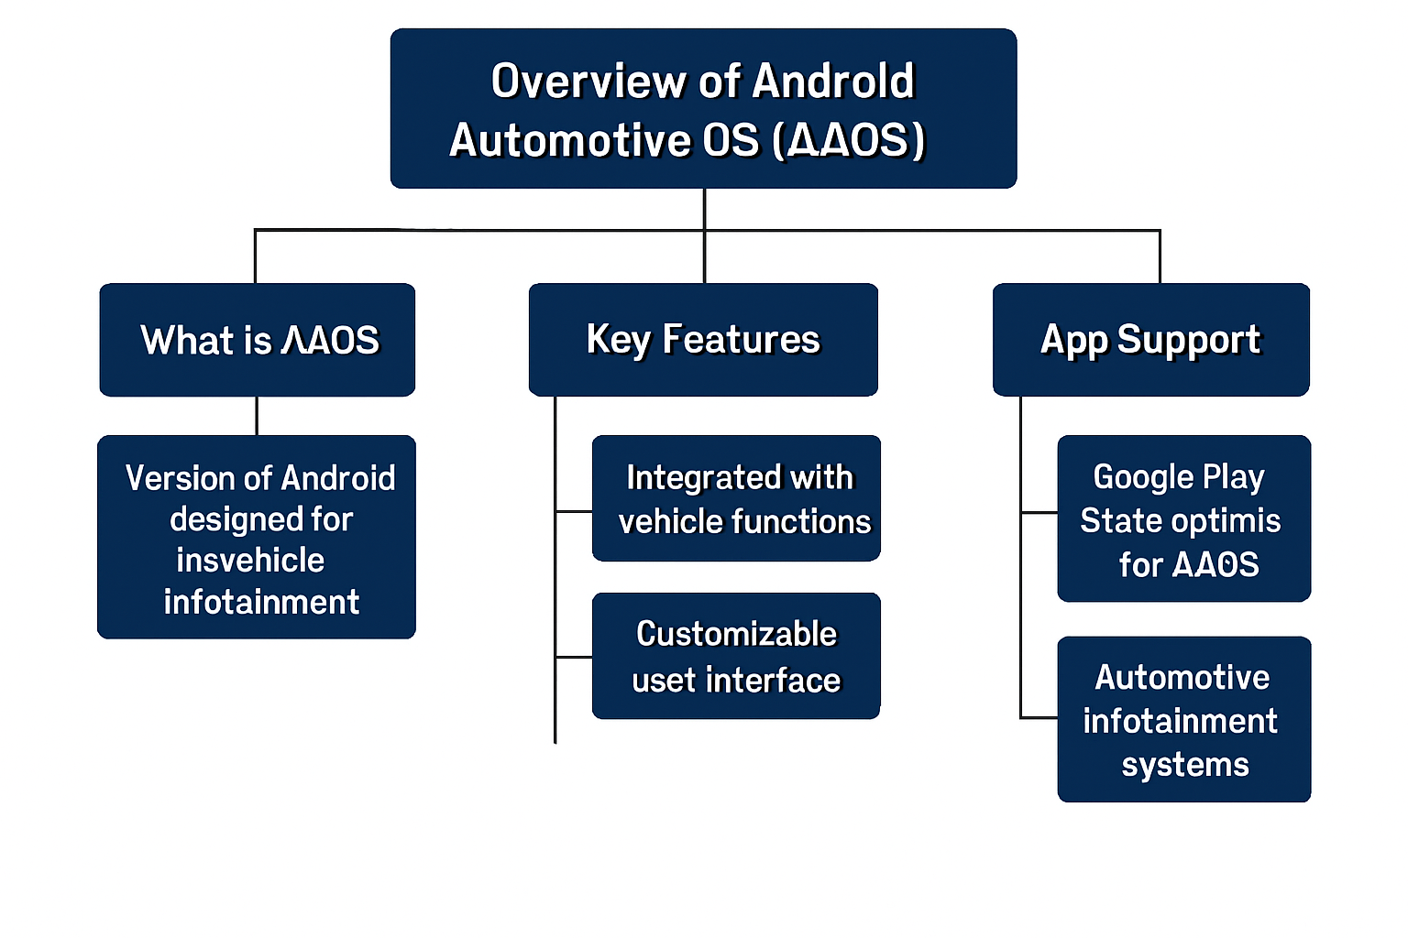

Slide 4





AAOS Architecture: Layered for Automotive Excellence
Application Layer
Car Launcher, OEM apps
Framework Layer
Car API, Android APIs
Service Layer
Car Managers, Services
Vehicle Hardware Layer
Linux kernel, BSP
The AAOS architecture is designed with distinct layers to ensure robust performance, security, and adaptability for the complex automotive environment. Each layer plays a crucial role in bridging user interactions with vehicle hardware.

Slide 5
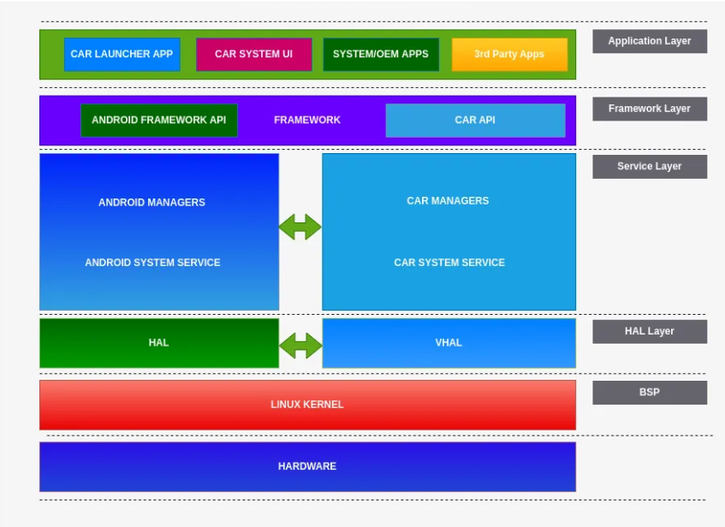

Slide 6
Deep Dive: Key Components of AAOS Architecture
Car System UI
Car API
Manages the user interface elements like status bars, navigation, and HVAC controls, all optimized for minimal driver distraction and ease of use while driving.
This crucial interface allows applications to securely access vehicle data such as speed, fuel levels, climate control settings, and other sensors, enhancing in-car app functionality.
CarService
Google Automotive Services (GAS)
A persistent background service that handles the integration of media, phone connectivity, and various vehicle systems, ensuring smooth operation and reliable communication between components.
Optional but powerful, GAS provides integrated Google services like Maps for navigation, Google Assistant for voice commands, and the Play Store for app downloads, enriching the user experience.

Slide 7

How AAOS Differs from Standard Android OS
1
2
Distraction-Minimized UI
Deep Hardware Integration
AAOS features a unique user interface with larger touch targets and a simplified layout, specifically designed to reduce driver distraction and enhance safety on the road.
Unlike standard Android, AAOS offers direct control over vehicle functions such as air conditioning, seat heating, and window operation, seamlessly integrated into the operating system.
3
4
Safety-First Design
Focused App Ecosystem
Every aspect of AAOS is built with safety in mind, limiting complex interactions and prioritizing intuitive voice commands to keep the driver's focus on the road.
The app environment is curated for driving needs, offering only navigation, media, and essential vehicle information apps, ensuring relevance and safety.

Slide 8
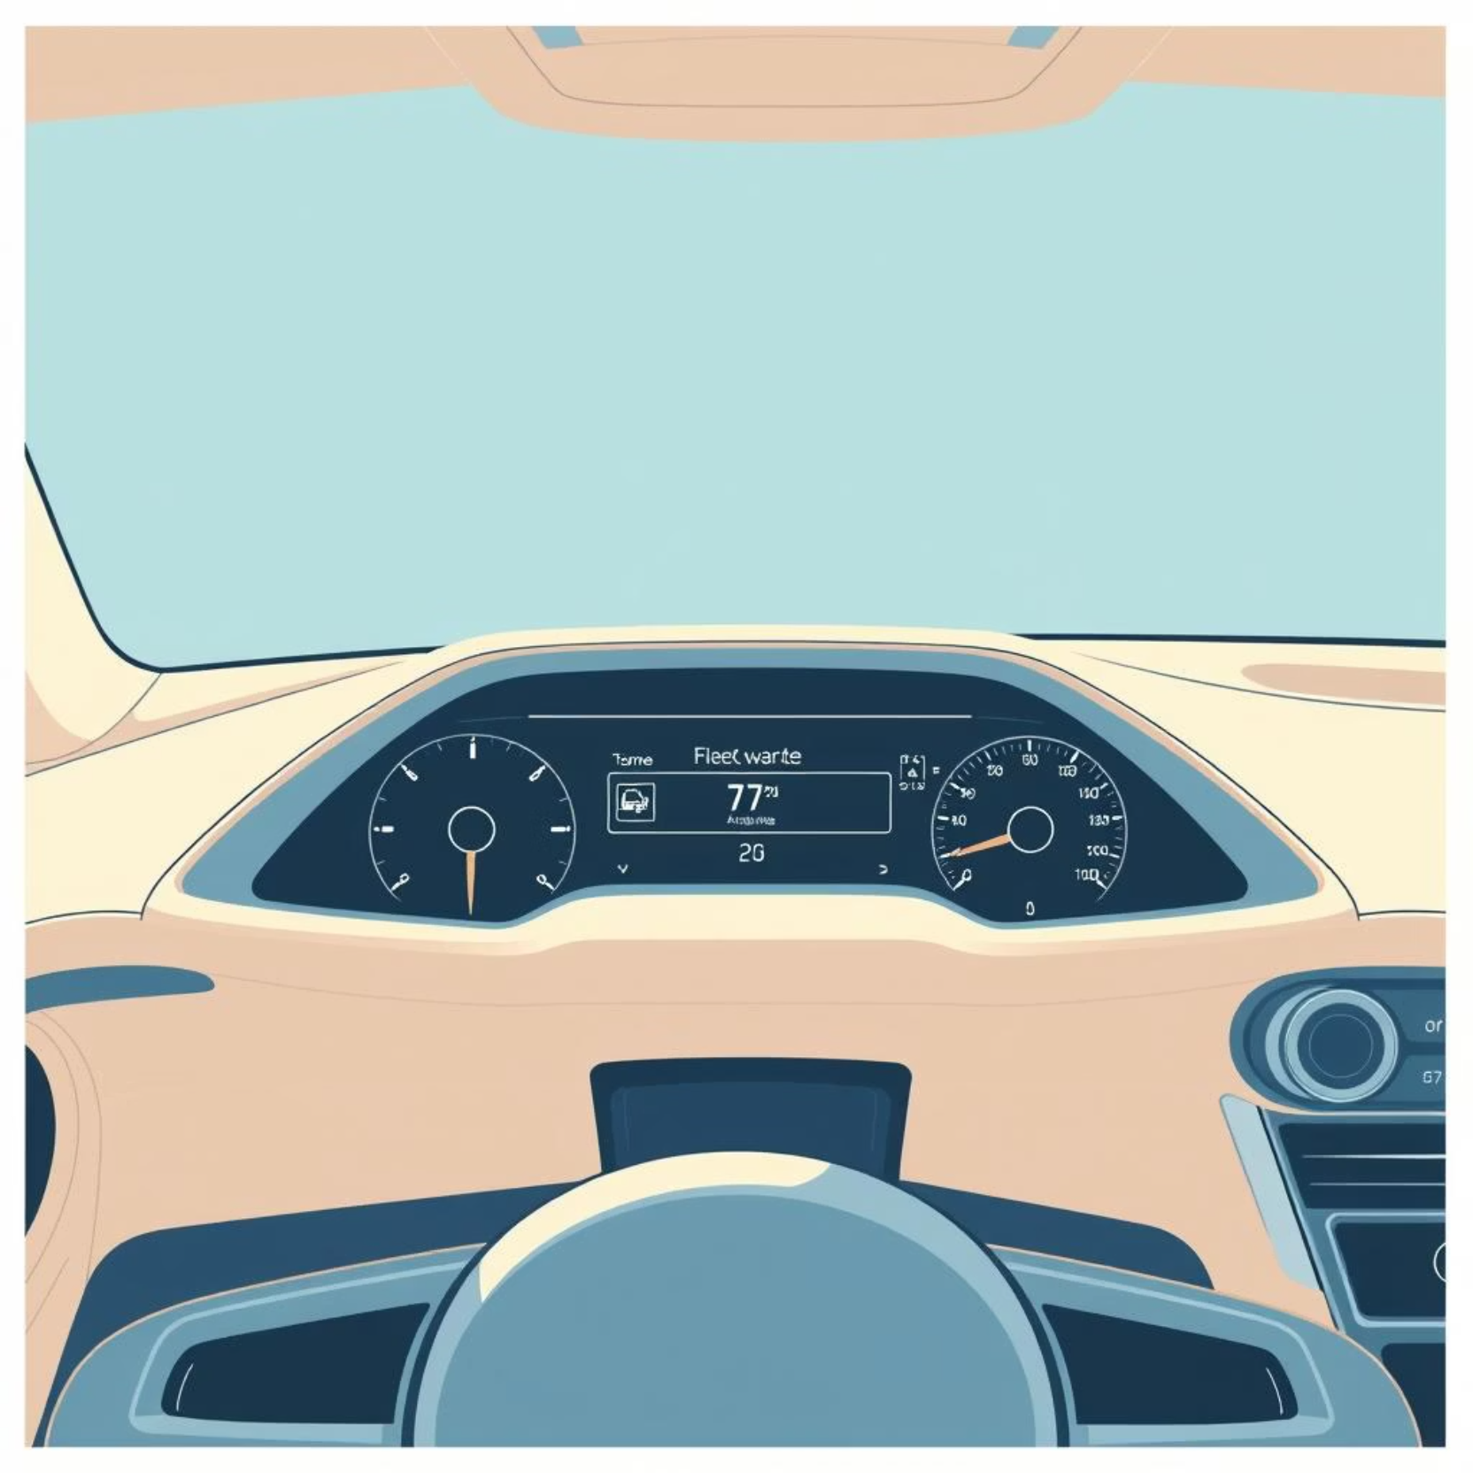
More Differences: Updates, Voice, and Hardware
Integrated Updates: AAOS updates are often bundled with the vehicle's overall software, managed directly by Original Equipment Manufacturers (OEMs) rather than mobile carriers, ensuring system cohesion and stability.
Advanced Voice Recognition: The voice assistant is specifically tuned to perform optimally in noisy car environments, accurately interpreting commands for navigation, media, and vehicle functions even with background noise.
Automotive-Tailored Hardware: AAOS is built for specialized automotive hardware, including direct integration with CAN bus systems, vehicle sensors, and diagnostic tools for comprehensive data access.

Slide 9
Standout Features of Android Automotive OS
1
2
Google Maps & Navigation
Google Assistant
Built-in, intelligent routing with real-time traffic, and specialized features like electric vehicle charging station search for seamless journeys.
Hands-free control for vehicle functions (e.g., climate, radio) and infotainment, enhancing convenience and reducing driver distraction.
3
4
Google Play Store
Customizable UI
Access to a curated selection of compatible, driver-safe apps designed for the automotive environment, ensuring entertainment and utility without compromising safety.
OEMs can leverage CarInfoManager to create unique UI themes and support multi-variant vehicle models, allowing for brand-specific experiences.

Slide 10
Benefits for Drivers and OEMs
For Drivers
For OEMs
Seamless Experience
Flexible Platform
Enjoy intuitive infotainment and integrated vehicle control from a single, cohesive system, enhancing convenience and ease of use.
Gain a highly customizable and flexible platform that significantly reduces development time and costs for in-car systems.
Enhanced Connectivity
Innovation Potential
Benefit from continuous improvements through quarterly updates, ensuring access to the latest features and security enhancements.
The open-source AOSP option empowers OEMs to build unique, differentiated experiences without dependence on Google Automotive Services (GAS).

Slide 11






Real-World Impact & Adoption
AAOS is rapidly gaining traction across the automotive industry, with major automakers worldwide integrating it into their latest models. This widespread adoption is enhancing both safety and convenience, leading to higher user satisfaction and strengthening brand loyalty. The platform also fosters a growing ecosystem of apps and services specifically tailored for the in-car environment.

Slide 12



Conclusion: Android Automotive OS Driving the Future of Connected Cars
Android Automotive OS is more than just an operating system; it's a transformative platform shaping the future of in-car experiences. By turning vehicles into smart, connected hubs, AAOS is paving the way for safer, richer, and more enjoyable journeys.
Holistic Solution
Innovation Catalyst
Future-Proofing
Its unique architecture and features adeptly address complex automotive challenges.
The platform's flexibility empowers OEMs and developers to innovate freely.
AAOS ensures a path to smarter, safer, and more enjoyable driving for years to come.

Slide 13


